Slide 1
Mexican-American War (1846 – 1848)
Everything You Need To Know For Your APUSH Exam

Slide 2
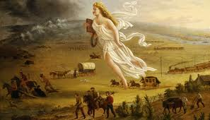
Manifest Destiny
What is it?
Belief that US had a mandate (direction from God) to expand from Coast to Coast
The South generally favored westward expansion
more land and spread of slavery

Slide 3
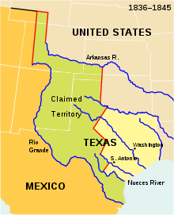
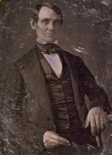
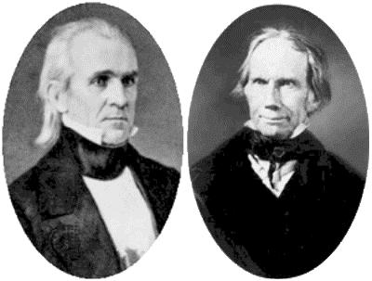
Events Leading to the War
Election of 1844
Clay (Whig) vs. Polk (Democrat)
Polk embraces Manifest Destiny and the annexation of Texas, defeats Clay ☹
Slidell Mission:
Polk wanted to purchase CA and settle boundary dispute along TX border
April 25, 1846 – Mexico attacks US troops on “US” soil
Spot Resolutions

Slide 4
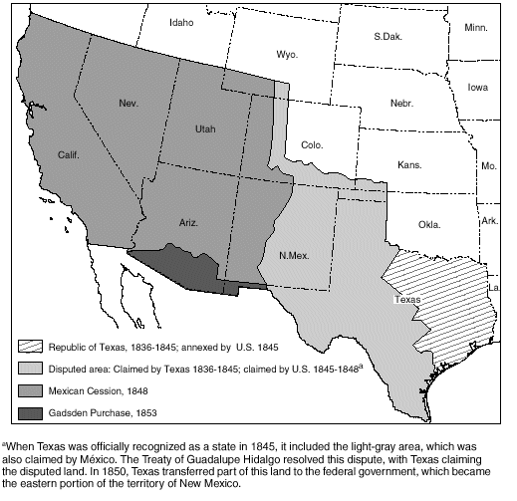
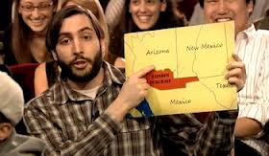
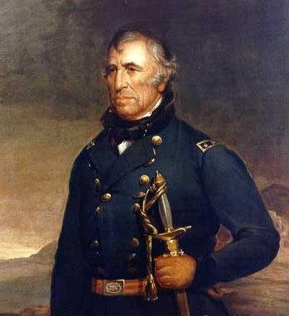
An Important Battle and a Treaty
Battle of Buena Vista
General Zachary Taylor becomes hero, president in 1848
Treaty of Guadalupe Hidalgo:
U.S. gained California, and modern-day NM, AZ, UT and NV -- ½ of Mexican territory
U.S. to pay $15 million
Watch Jimmy Fallon’s skit on the Gadsden Purchase!

Slide 5
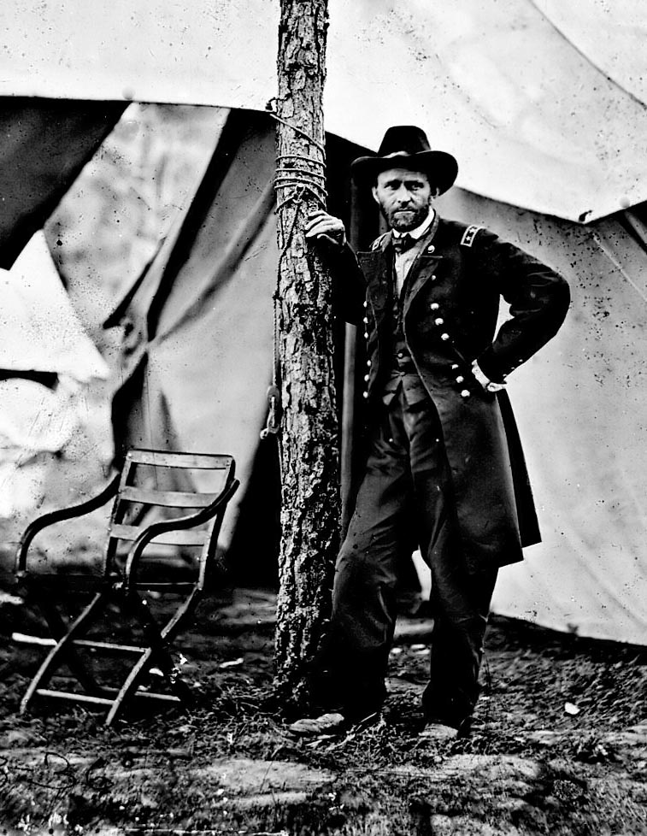
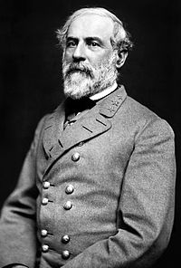
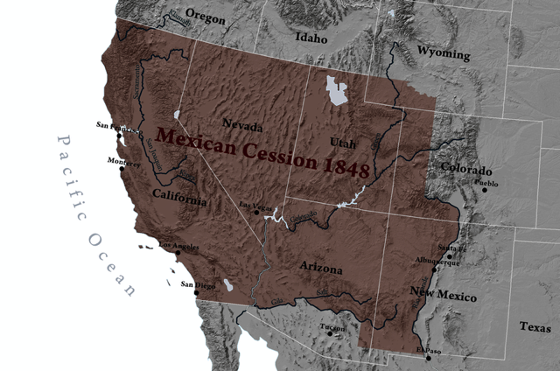
Effects of the War
America increased its size by 1/3
Future generals emerge
Debate over slavery continues
Wilmot Proviso
Compromise of 1850

Slide 6
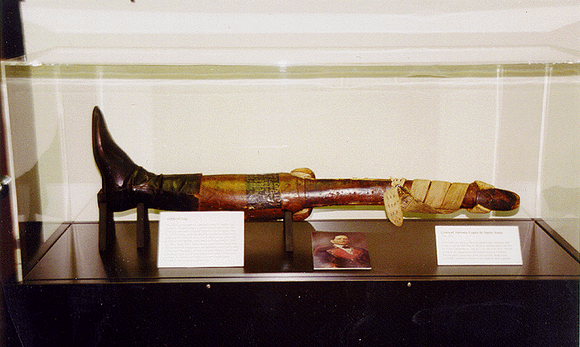
Good luck on your APUSH exam!

